Slide 1
Airline Management System
By: Naveed, Arunim, Sahil, Anukool and Karthik

Slide 2
Objective of our project
Airline management system we have developed is a solution to business and financial problems in one platform. Accessibility, ease of use and light resource dependency were the main issues of focus that were undertaken during the entire design phase of our project. The Graphical User Interface is extremely user friendly and the users can easily navigate through the platform to access its different features. The system is designed and built in such a way that it can be used to manage the airline bookings/ cancellations and can be handled by any end user scenario, that is, by customers or admins.

Slide 3
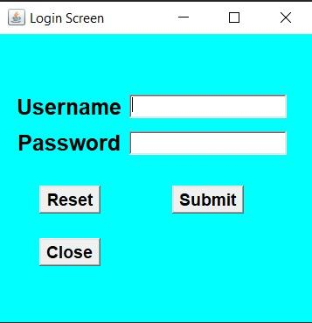
Brief overview of our project
Login screen :
A simple login screen for the user to enter their username and password.
Default username: admin
Default password : admin

Slide 4
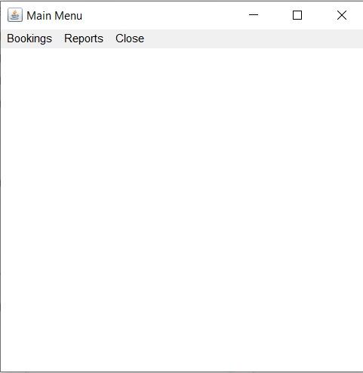
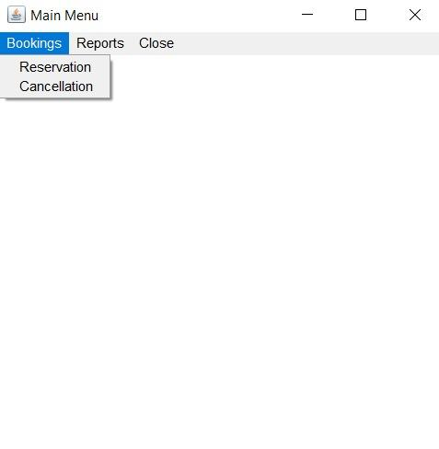
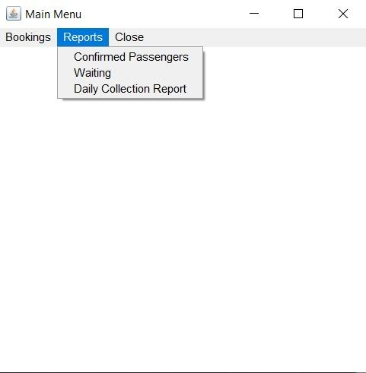
Main menu :
This is the first tab that opens after the user logs in. It displays all the available features in our software.

Slide 5
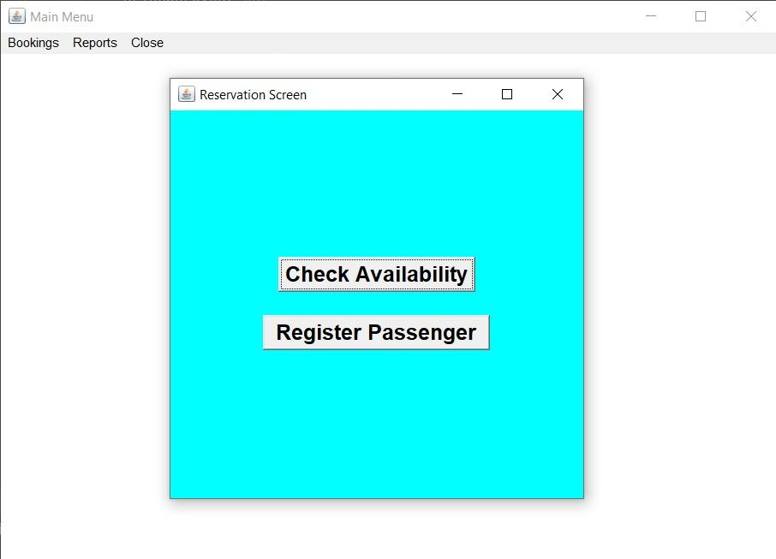
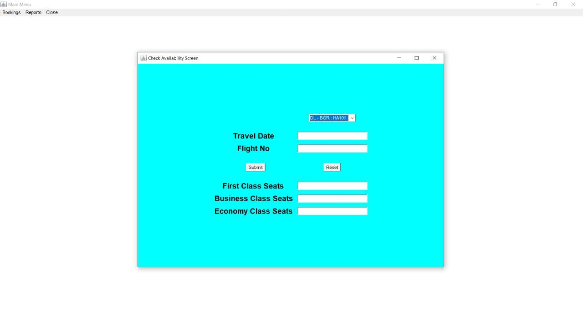
Reservation screen :
The reservation screen displays two options :
(1) check flight availability
(2) register as a new passenger

Slide 6
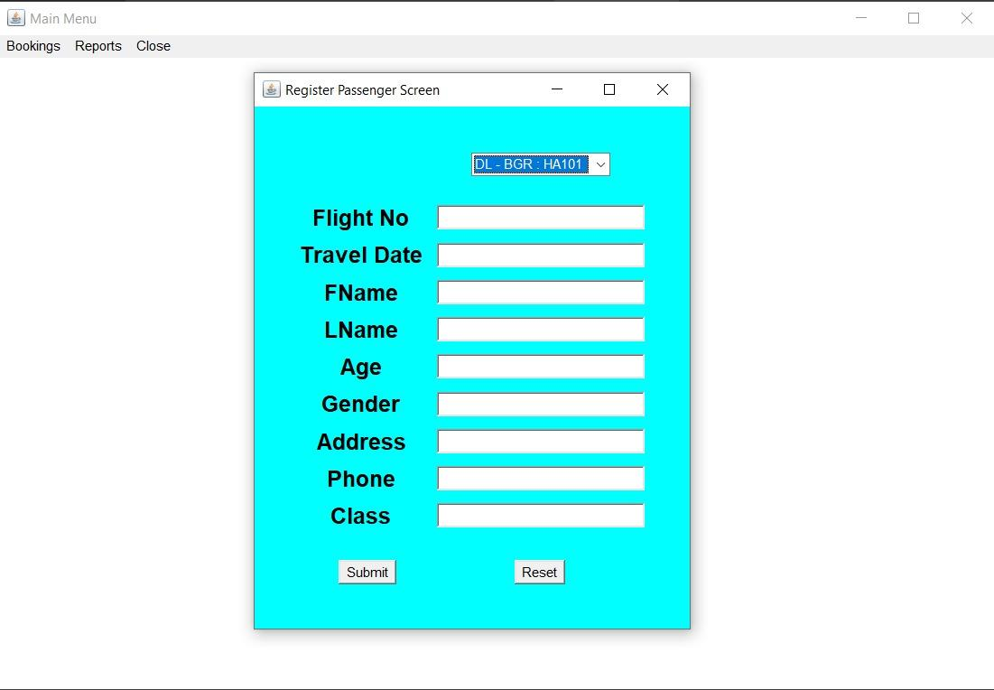
Register a new passenger :
This is the registration window which allows the user to fill their details in order to register themselves and book a flight.

Slide 7
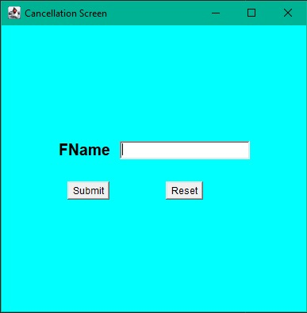
Cancellation screen :
The user can cancel their flight reservation by entering the first name .

Slide 8
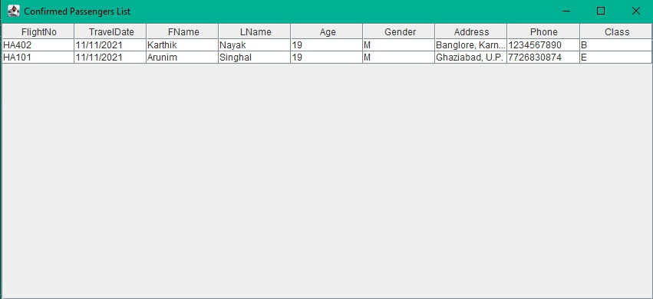
Reports : confirmed passengers list
Here the admin can check the passenger’s details

Slide 9
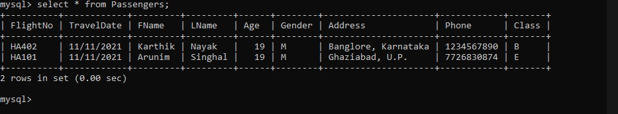
BACKEND (DATABASE)
→ Hosting platform : WAMPP server application
→ Port : Local host 8000
Database : MySQL

Slide 10
JAVA properties that were used
Java awt.swing; package - for the user interface
JDBC - linker to database
SQL database software to manage data
Java object oriented methodology (inheritance, abstraction, encapsulation)

Slide 11
Real world applications of our project
Airline management systems (AMS) are systems that allow an airline to sell their inventory (seats). It contains information on schedules and fares and contains a database of reservations (or passenger name records) and of tickets issued (if applicable). AMS’ are part of passenger service systems (PSS), which are applications supporting the direct contact with the passenger.

Slide 12
Possible improvements in the future
We can further improve our project by hosting it online and thus make it scalable and enable any user to download and use the software.
There is also scope for improvement in the user experience in terms of GUI.
We can also centralize the database by hosting it on a cloud platform, firebase or any other such platform. Any changes in data (reservations / cancellations) on individual systems will be reflected in the database.

Slide 13
Contribution of Members :
Karthik - Reservation, Collection & Warning
Arunim- Login, MessageBox & Confirmed
Naveed - Check & Cancellation
Sahil - Create & Project
Anukool - Main menu, Change & Waiting
→ (PPT is made collectively)

Slide 14
Conclusion
This project has been very helpful to each one of us to learn teamwork and make a real world application-based product which has the potential to help people and make the process of ticket reservation hassle-free.
We learned many new concepts and their application through this project. We learned a new aspect of java programming which is UI designing by using Swing and database management through JDBC.

Slide 15
THANK YOU

